Slide 1

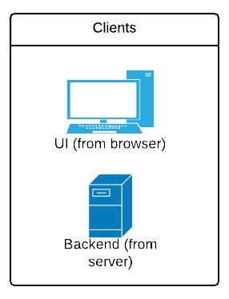



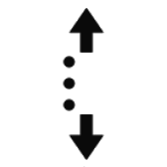
Notification architecture
Subscribe queque
update
Notify user socket send message
Subscribe
update
Websocket connection
publish
Subscribe
New http request
(/notify rest service)
update
Subscribe

